Slide 1
Climate Vulnerabilities
North Western Himalayas
Environics Trust

Slide 2
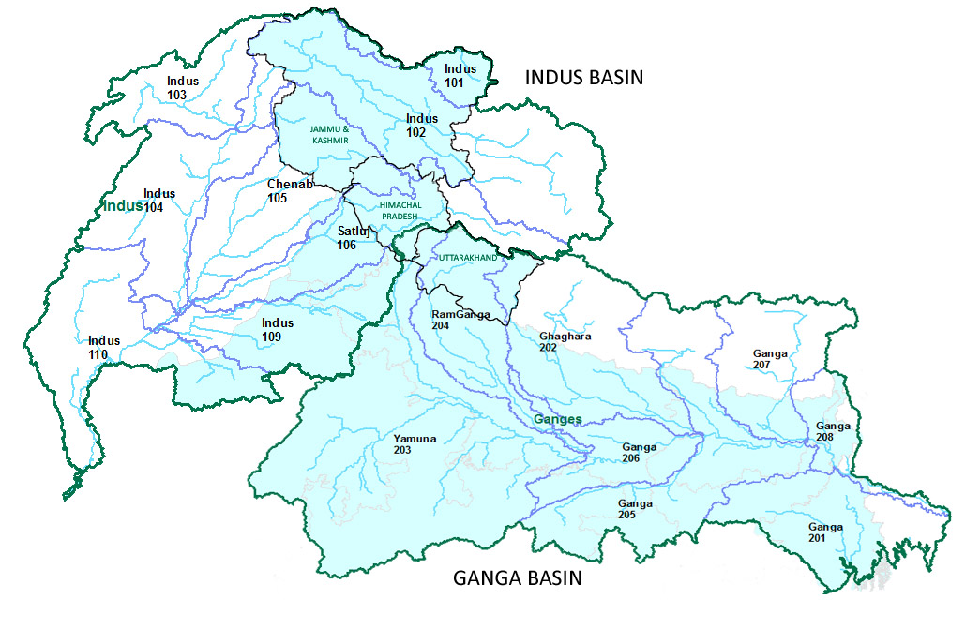

Slide 3
Vulnerability
  By events which are geologically induced (earthquakes, young formations etc.) but are visible
  By events triggered by State’s development of physical infrastructure with least understanding of physiographic nature
  By events which are an outcome of larger weather phenomenon and which are not visible or for which the source of impact cannot be easily pointed at, like temperature rise, increased or decreased rainfall

Slide 4
High Altitude Environmental Components
Glaciers & Glacial Fed River Systems
High Density Forests & low Density Population
Protected Areas (NDBR, Valley of Flowers), Alpine Shrubs and Meadows
Vulnerable are communities in the Glacial Margins as well as those with livelihood based on restricted resources (National Parks)

Slide 5
Mid Altitude Environmental Components
Rainshadow Areas & Hydro Projects
Valley Agriculture & Horticulture Potential
More Urbanisation and Physical Development
Intense Development Activity
Vulnerable are farming communities, graziers especially nomads

Slide 6
Low Altitude Environment Components
Agriculture dominates Land Use
Urbanisation Continues (63 Urban Centres in Uttarakhand)
Protected Areas, Industrialisation and Poor forests
Bhabar – Terai Region
Vulnerable are farming communities but the risk is for larger population is due to additional pollution

Slide 7
Vulnerability Parameters
Geological Transformational changes natural, stressed further due to developmental activities.
Carbon neutral settlements few, in interiors
Small farmlands (MARGINAL LAND HOLDINGS LESS THAN 1 HECTARES = 6,28,000), inputs cost high (material, labour)
Abrupt Temperature Variance disturbing sowing-harvesting cycles
Western Disturbance prolonging – erratic rainfall, humidity, moisture conditions!
Monocultures – reduces both floral and fauna diversity. Outcome of Forest Diversion for large projects. 626 sq. km in UKD; >150 sq. km in HP?
Climate too risky for cash crops / horticulture crops (mid to big farmers). Cereal crops – small & marginal farmers

Slide 8
HISTORICAL EVIDENCE, LESSER NORMALS!
District wise Comparison of Annual Normal Rainfall with Frequency of Annual Rainfall in District
Districts | Average Annual Rainfall Normals (mm) | No. of Years of Data | Percentage of Cases (years as in Col.III) occurring w.r.t. Rainfall Normals
 |  |  | Normal | Excess | Low
Col. I | Col. II | Col. III | Col. IV | Col. V | Col. VI
Bilaspur (300-900m) | 1256.7 | 37 | 18.92 | 40.54 | 40.54
Hamirpur (300-900) | 1462.6 | 32 | 15.63 | 40.63 | 43.75
Una (300-600m) | 1209 | 31 | 12.90 | 58.06 | 29.03
Mandi (900-1800m) | 1564.6 | 45 | 13.33 | 42.22 | 44.44
Chamba (1800-4500m) | 1355.1 | 35 | 5.71 | 37.14 | 57.14
Kangra (600-900m) | 1852.3 | 39 | 5.13 | 30.77 | 64.10
Sirmour (300-900m) | 1688.7 | 46 | 8.70 | 47.83 | 43.48
SHADED PORTIONS ONLY DEPICT CLUBBING OF ALTITUDE CLASSES TO COMPARE (THESE ALL ARE ADJOINING DISTRICTS WITH LARGE VALLEY FORMATIONS) AS THESE ARE ADJOINING REGIONS AND LIE OVER MORE OR LESS IN THE SAME LONGITUDE! VARIANCE SEEN ACROSS THE AGRO CLIMATIC REGIONS

Slide 9
Districts in Himalayan Regions in order of their Altitude Variations or Ranges
State | Districts | Altitude Range (m) Low – High | Predominant Altitudinal Profile in District | Some Key Factors | Some Events of Cloudburst
UKD | Udham Singh Nagar | 150 – 300m | 150 - 300m | Distilleries and Other industries
HP | Una | 300 – 900m | 300 – 600m | Industries
UKD | Haridwar | 150 – 1350m | 150 – 600m | Industries (IEE), Stone Crushing
HP | Hamirpur | 300 – 1350m | 300 – 900
HP | Sirmour | 300 – 1800m | Shivalik & Mussourie Range – 300 – 600m & 1350 – 1800m | Mining in 2 blocks, Industrial belt in Paonta | Rajgarh Tehsil (06.08), Sadhauara bridge (08.07), Pain Kuffar Village (Rajgarh – 09.08)
HP | Bilaspur | 300 – 1800m | 300-900m | Cement Plants, Bhakhra’s Govind Sagar Reservoir, River Bed Mining
UKD | Champawat | 150 – 3000m | 900 – 1800m
UKD | Nainital | 150 – 3000m | 300 – 600m , 600 – 900m | Lower parts like Dhaula Kuan etc. industrial belts, Urban Centre
JK | Jammu | 150 – 3000m | 150 -300m, 300 – 600m, 900 – 1350m
HP | Solan | 300 – 3000m | 300 – 600 & 1350 – 1800 | Mining & cement, Industries, Urban Centre, River Bed Mining, Industrial Hubs (Kala Amb, Baddi)
UKD | Dehradun | 300 – 3000m | 900 – 1800m | Industrial estate, Urban Centre
UKD | Pauri Garhwal | 300 – 3000m | 900 – 1350m & 600 – 900m
JK | Kathua | 600 – 3000m | 300- 600m, 600 – 900m
JK | Rajauri | 600 – 3000m | 600 – 900m
HP | Mandi | 600 – 3000m | 900 – 1800 | Cement, Industrialisation on pick | Manjhainalah near Athamille area (08.11), Dhundi area (07.11), Pandoh (08.11)
UKD | Almora | 600 – 3000m | 900 – 1800
JK | Pulwama | 1350 – 3000m | 1350 – 1800m, 1800 – 3000m

Slide 10
JK | Udhampur | 300 – 6000m | 900 – 1350m
UKD | Pitthoragarh | 600 – 6000m | > 4500m, 900 – 1350m & 1800 – 3000m | Mining, HEPs | Munsiyari (2010),
UKD | Bageshwar | 900 – 6000m | 1800 – 3000 | Mining, HEPs
UKD | Chamoli | 900 – 6000m | 4500 – 6000, 3000 – 4500 & 1350 – 1800m | Mining, HEPs | Badrinath (2004)
JK | Doda | 900 – 6000m | 1800 – 3000m |  | Assar-Baggar (06.11)
UKD | Rudraprayag | 900 – 6000m | 1350 – 3000m, 3000 – 4500m
UKD | Uttarkashi | 900 – 6000m | 4500 – 6000m, 3000 – 4500m, 1350 – 1800m | HEPs
JK | Anantnag | 1350 – 6000m | 1800 – 3000m, 4500 – 6000m
HP | Shimla | 1350 – 6000m | 1350 – 1800m, 1800 – 3000m |  | Chirgaon in Rohru & Wangtu-Neugal Seri in Kinnaur side | Cloud burst in Rohal mountain range (1997) killing over 120 persons
JK | Baramulla | 1350 – 6000m | 1350 – 1800m
JK | Budgam | 1350 – 6000m | 1800 – 3000m
JK | Kupwara | 1350 – 6000m | 1350 – 1800m followed by 1800 – 3000m
JK | Kargil | 1800 – 6000m | 4500 – 6000m, 1800 – 3000m
HP | Kangra | 300 – 7500m | 600 – 900
UKD | Chamba | 600 – 7500m | 1800 – 4500 |  | Udaipur (06.11) Rohtang Tunnel; Claimed 60 lives in same area in 2003
HP | Kinnaur | 1350 – 7500m | 1350 – 3000m, 3000 – 6000m | HEPs | Sangla Valley (08.07), Kaamru Nala and Barang Nala in Sangla
HP | Kullu | 1350 – 7500m | 1350 – 1800 | HEPs | Gursa Tehsil (2003), Upper Manali (07.11; 8 & 22), Tharman Village (08.10)
HP | Lahaul & Spiti | 3000 – 7500m | Lahut Valley, Sarchu Peak (5741m), Chenab Sub Basin, Mulkila (6417m)
JK | Leh & Ladakh | 3000 – 6000 & > 6000m | 3000 – 4500m, 4500 – 6000m |  | Leh (08.10)

Slide 11
Glacier Retreat -
 | No. of glaciers Monitoried | Retreat | Advance | No Change
Fluctuations in different basins based on SoI maps and satellite images | 2630 | 2047 | 435 | 148
 |  | 77.83 % | 16.53% | 5.62%
Fluctuations based on Satellite images | 2190 | 1673 | 158 | 359
 |  | 76.39% | 7.21% | 16.39%
Spiti Basin – Interpretation of glaciers in this basin indicate that there is rapid retreat after 2001 and this is the highest among all basins!
Alaknanda & Bhagirathi Basin - Glacier retreat for this basin after 1990 is much rapid whereas glaciers in Bhagirathi basin which is adjacent to Alaknanda basin has shown slow retreat after 1990.
Bhaga & Chandra Basin - Bhaga basin is located in similar climatic conditions as Chandra basin but glaciers of Bhaga basin show higher rate of retreat as glaciers here are debris free. Another reason is the small size of glaciers indicating smaller depth

Slide 12
Specifics Contexts
Vulnerability further rises for communities dependent on commons for livelihoods
  In stretches where hydro projects have resulted in dry river stretches
  Glacier retreat (considering variety of factors) occuring, secondary events in absence of physical structures on Rivers may have been less vulnerable for communities?
  Thereby changing the micro climate of these particular stretches which may affect communities on either side (meteorological conditions)

Slide 13
D
I
R
E
C
T
I
M
P
A
C
T
S
Vulnerabilities and Impacts on Land Based Production Systems in the Himalayas
Crop (Value & Food Security) | Popular Belts / Eco Regions | Scale | Fragility | Remarks / Quotes
Apple | Grown in Mid to high hill climates. Fruit belts in Shimla, Kullu, Chamba Kinnaur, Sirmour and Mandi districts | Apple farming extends to over 1 lakh hectare and forms almost 45 – 50% of the land under fruits. 83% of 592 million tonnes apple of total fruits. | During July 2009, over 30 per cent crops at heights between 4000’ to 5500’ were damaged due to hailstorm. | As per government, almost 900 crores worth of crop is lost over the last three years. Kothgarh-Thanedar is one of the prominent apple growing belts in District Shimla which is severely impacted this year. Cherry, pear and peach are also affected.
Apple |  | Dry season in the valley is progressing has created a disturbance in the sowing and growth of different crops and will also severely affect the fruit crops if the trend continues | The period when chilling temperatures are required for the crop, Kullu region observed dry cold wave. | There is still no evaluation on the estimation of 1⁰C increase in temperature in Himalayas as to what additional resources will be compromised like water, crop area, forest fires etc.
Replacement for Apple |  | From Apples to growing the more exotic nectarine. Nectarine can grow at low altitudes. | This suggests a kind of adaptation measure by planting the exotic species from USA? | With the expansion of other horticulture crops like cherry, kiwi, apricots, strawberry, olive, almonds and plums is targeted to replace vulnerable crops like apple which is by far the major contributor of horticultural produce (>80%)
Replacement for Apple | High reaches of Shimla, Kullu, Mandi, Chamba, Kinnaur and Lahaul and Spiti are ideal for cherry cultivation Cherry (flowering March-April) | As per horticulture department estimates, at least 10,000 farmers, most of them with small land holdings, grow cherries over an area of 374 hectares. The areas are more prone to weather uncertainties like erratic rainfall, hailstorms and even long dry cold spells. | Requires less caring but fetches proportional price. | Himachal Pradesh produced 453 tonnes of cherry in 2008-09, though it was higher in 2007-08 - 698 tonnes
Kiwi | Shimla, Kullu, Chamba Kinnaur, and Mandi districts | Four different varieties of Kiwi fruit being cultivated in the hilly state (Hayward, Monty, Bruno, Allison) | Subsidies given 22,000/hectare & export to megacities in India
Oranges |  | Due to the change in weather, we are facing a lot of problems from the last eight to ten years. It's not raining on time because of which the plants are getting dried. The orange cultivation in this area is almost finished," said Ramesh Pathania, an orange grower | Orange is grown in over 25,000 hectares of land in the State. Out of this, 80 percent cultivation is done in Kangra valley.
Strawberries | Sirmour in the temperate zone accounts for 90% of the estimated production in the state of Himachal Pradesh. | Prominent belt along Poanta – Dhaula Kuan but it is also grown in lower/mid hills of Kullu, Kangra, Una and Shimla. |  | High value crops are taking a leap forward and most of them find markets outside the state.

Slide 14
Crop | Popular Belts / Eco Regions | Scale | Fragility | Remarks / Quotes
Off Season Vegetables | Shimla, Solan, Sirmour, Kullu, Una and Kangra (off- season vegetables - cabbage, cauliflower, peas, tomato etc.). | Solan belt is popularly known as the area of Red Gold because of its tomato production | Off-season vegetable production, which was nearly 34-35 thousand tons earlier, has now increased to 1/3rd | Farmers are increasingly looking forward to off season vegetables as these fetch high prices when the production period is over elsewhere. (see below)
Vegetables |  | The drought like situation in Kandaghat area of Himachal Pradesh has damaged a major area of vegetable crops.Over 60 percent of the crops have been damaged, delaying the transplantation in the area. | tomato, capsicum, brinjal and cauliflower and our economy depends on these vegetables | However, there has been an increase in vegetable cultivation area from 25,000 hectares to 50,000 hectares in the state during the last few years.
Wheat and Cereal Crops | This temperate mid zone occupies approximately 32% of geographical area and 37% of cultivated area (Himachal Pradesh) and ranges from 650 m – 1800 m which means 5-6 Himalayan Districts (refer table above). This belt is also good for cash crops like off season vegetable, ginger and high quality seeds. | As per National Wheat Research Centre’s analysis a long dry spell affected the wheat crop in the lower hills. Now, heavy rain accompanied with hailstorm and high velocity winds is flattening the ripe wheat crop.' | Yield of the wheat this year is expected to fall 20-30 percent due to hostile weather at the time of harvesting. About 81 percent of the total cultivated area in the state is rainfed. Rice, wheat and maize are the important cereal crops | The uncertain weather patterns have kept the farmers guessing and there is no adaptative measure as this is a rainfed area and bringing in other crops would mean more investments and also know how. Ginger is grown in Kadukhal (district tehri), Ginger production in HP rose to 21,267 tonner in 2010-11 which is an increase of over 6000 tonner from the previous year
Forest Fires | As reported in 2009, the meteorological office (HP) stated that the mean maximum and mininimum was 1 – 4⁰C above average. | In 2009 alone, over 650 incidents of forest fires were reported from Shimla, Solan, Sirmaur, Bilaspur, Mandi, Kangra, Hamirpur, Una and Mandi districts whereas the number was 572 in 2008. Fires could break out due to the long dry spell and unprecedented hot weather. It is estimated that around 7900 hectares of forest land has been destroyed due to unprecedented fires. | In a report by Council for Science, Technology and Environment, there are 447 reported species in Himachal (out of 1228 reported species in India). Similarly, 77 species of mammels (snow leopard to Himalayan Tahr) are found here. The storehouse of biodiversity also supports 3,120 species of flowering plants, including 187 species of medicinal plants | Looking this from the backdrop of biodiversity, which is quite rich in this Himalayan State, the results coupled with this factor (forest fires) may also displace or force migration to other regions. E:g Himachal is home to 36% of country’s bird species.

Slide 15
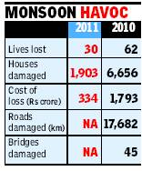
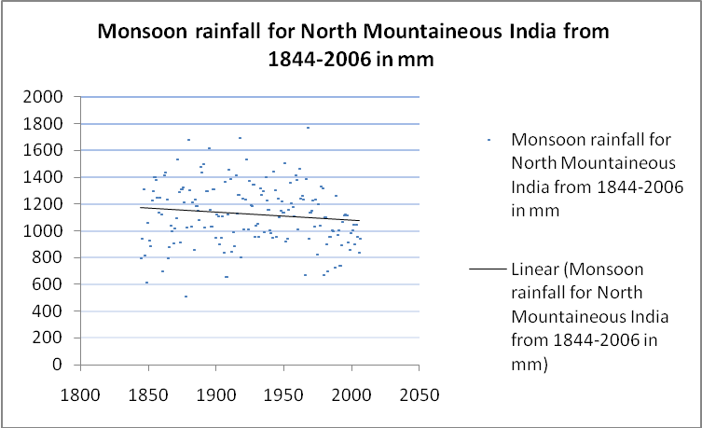
Science & People’s Perception
Agriculture more rainfed , total area under land holdings is 843,000 hectares; Net irrigated areas is only 14%?
In the monsoon of 2010, many areas in Yamunotri valley experienced severe floods because of intense rainfall in a short period

Slide 16
THE TWO MAIN SEASONS!
The General perception is that seasonal fluctuations were not frequent as they have been over a shorter period of 2-3 years duration recurrence.
Few of the older people in villages mentioned that if the rainfall is more gradual and prolonged, it causes good snow. As in the recent times the rain has become less gradual and more short and intense, it does not trigger snowfall.

Slide 17
PRODUCTION
Increasing instances of pest attacks and survival as the warmer periods prolong.
Mid Hills which forms productive agricultural belt has seen reduction in productivity. People say, getting back to the traditional system of multiple cropping may have to be followed as risks are higher now with single crops.

Slide 18
Reducing Vulnerabilities
CROP INSURANCE :
  HOW THE CURRENT MODELS BE REFRAMED BOTH ECONOMICALLY AND GEOGRAPHICALLY?
  AND TO COVER MARGINAL LANDS WHICH HAVE LARGE DEPENDENTS?
EARLY WARNING SYSTEMS : BOTH SCIENTIFIC AND TRADITIONAL
FLASH FLOOD PREVENTION: community-based flash flood risk management plan
MANAGING WATER RESOURCES:
  HILL ACQUIFERS
  MICRO WATERSHED STRENGTHENING

Slide 19
INCREASING RESILIENCE
STRENGTHENING AND ENHANCING OBSERVATIONAL AND MONITORING MECHANISMS AT MICRO WATERSHED LEVELS.
  THIS WILL ENHANCE EARLY WARNING CAPABILITIES
  MAY GIVE TIPS FOR LONGEVITY TO LIVELIHOOD’S SUSTENANCE
SEED MANAGEMENT
  TRADITIONAL VARIETIES WITH AGRO CLIMATE SUITABILITY NOW
CROP DIVERSIFICATION & ALTERNATE LIVELIHOODS
  DIET, FOOD SECURITY AND IN ADDITION ENHANCING HOUSEHOLD BASED ALTERNATE PRODUCTION SYSTEMS

Slide 20
ADAPTIVE CAPACITY
TAKING INTO ACCOUNT REDUCING VULNERABILITIES AND INCREASING RESILIENCE; BACKING COMMUNITIES WITH INFORMATION
  TO PLAN ADEQUATELY TOWARDS THEIR FOOR SECURITY
  TO PLAN ADEQUATELY TOWARDS LIVESTOCK NEEDS AND ALTER USES
  TO UNDERLINE KEY INDICATORS AS TO TAKE LEAD FOR THIS PLANNING IN ADVANCE
  TO ENGAGE IN EASILY CONVERTIBLE ACTIVITIES WHICH MAY NOT BE LAND BASED BUT (BASED ON AGRI-WASTE) AS A BRANCH OF AGRICULTURE

