Slide 1
“ We have the moral responsibility to bequeath to our children a world
which is safe, clean and productive,
a world which should continue to inspire
the human imagination with the immensity of the blue ocean, the loftiness of snow-covered mountains,
the green expanse of extensive forests and the silver streams of ancient rivers

Slide 2
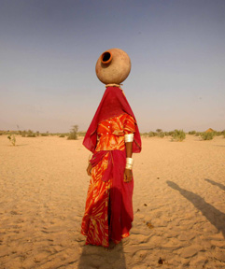
Karnataka Climate Change Action Plan
Disconnect between rhetoric and reality
Do people matter?
Kuldip Gyaneswar & Pavan Srinath
Environmental Governance Group
Public Affairs Centre

Slide 3
Environmental Governance Group
“ Without a careful long-term strategy, climate change may undermine our development efforts, with adverse consequences, across the board, on our people’s livelihood, the environment in which they live and work and their personal health and welfare
Public Affairs Centre

Slide 4
The National Plan to states
Tracing the trajectory
Environmental Governance Group
6th June 2007
  PM’s Council on Climate Change constituted
30th June 2008
  National Action Plan for Climate Change released
18th August 2009
  National Conference of Ministers of Environment & Forests
PM urges States to come out with State Climate Change Action Plan
19th August 2010
  Common framework for preparation of SAPCC devised and shared with states
  (UNDP, World Bank, GTZ and DFID)
Public Affairs Centre

Slide 5

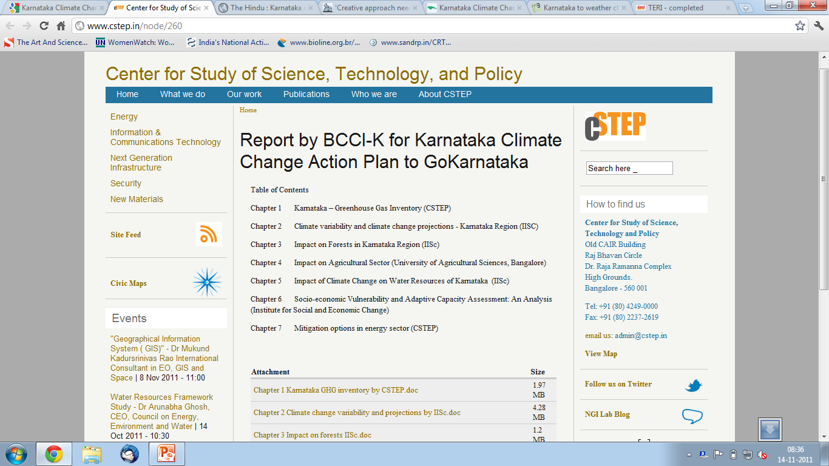
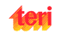
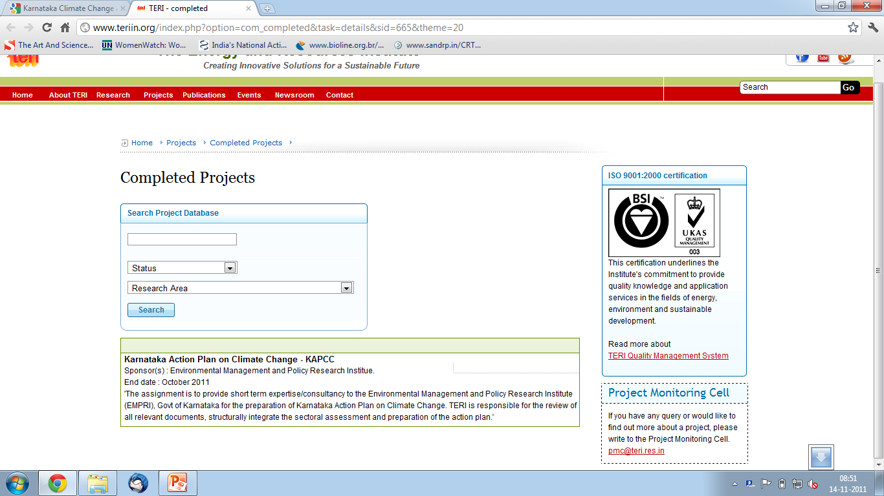

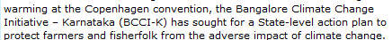

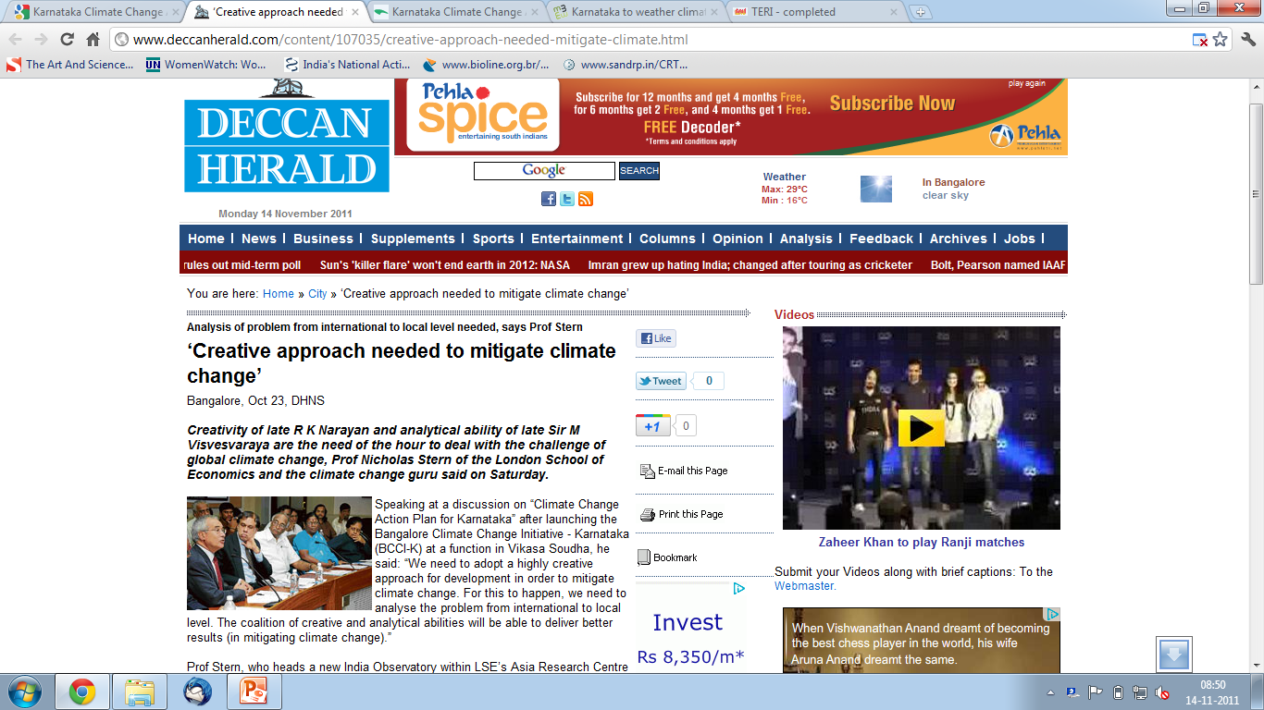
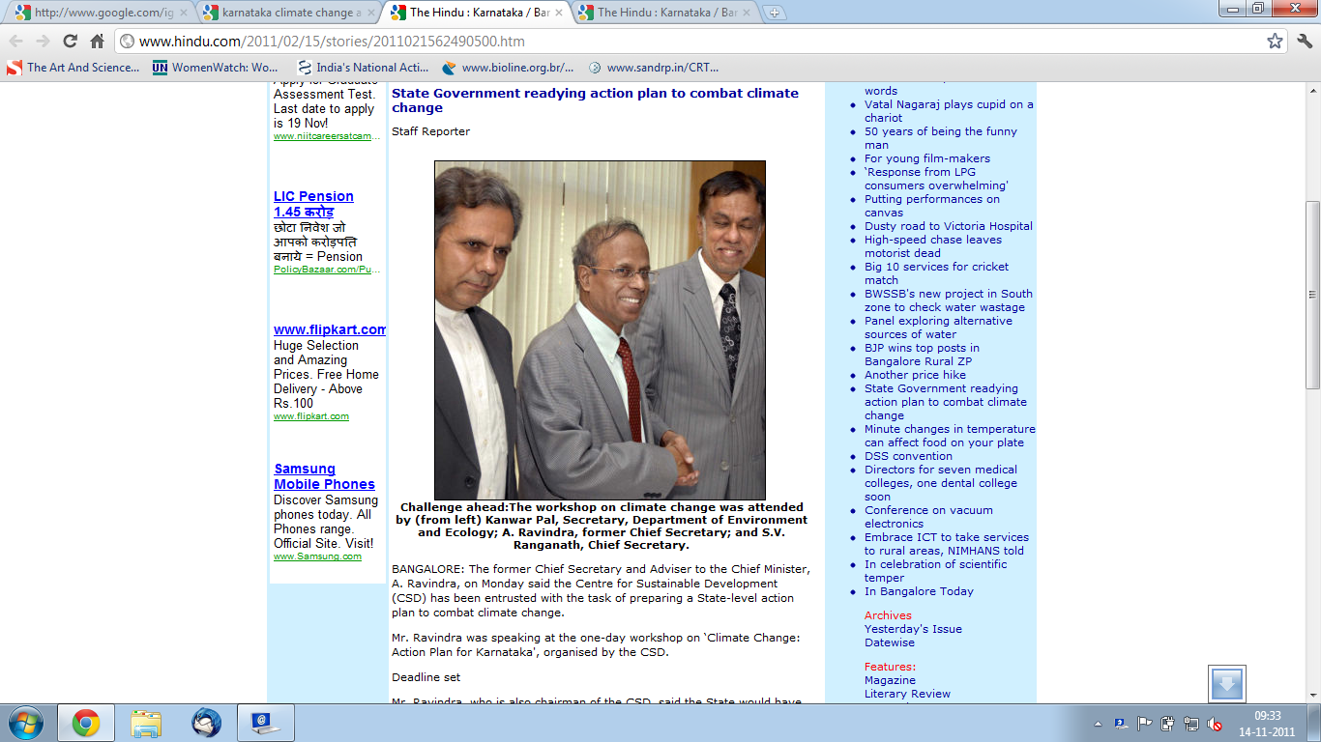
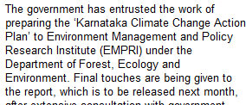
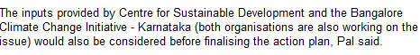

Slide 6
Demystifying the Case of Karnataka
Environmental Governance Group
June 2009
  Coordination committee constituted
October 2010
  Bangalore Climate Change Initiative – Karnataka launched
  comprising scientists from the Indian Institute of Science, the University of Agricultural Sciences, the Institute for Social and Economic Change and Centre for Study of Science, Technology, and Policy
November 2010
  Environmental Management and Policy Research Institute (EMPRI) is entrusted with the responsibility of preparing the plan
December 2010
  EMPRI releases the Rapid Assessment Report
  Organizes a consultation with invited and restricted groups
Public Affairs Centre

Slide 7
Demystifying the Case of Karnataka
Continued…
Environmental Governance Group
February 2011:
  Centre for Science and Development (CSD) organizes a consultation
June 2011:
  Report by BCCI-K released
September 17th 2011:
  Draft State Climate Change Action Plan released by EMPRI
(comments solicited till October 12th)
Public Affairs Centre

Slide 8
Mapping the process
Environmental Governance Group
Government of Karnataka
MOEF, Govt of India
The Energy Research Institute
Coordination Committee
Centre for Science and Development (CSD)
BCCI - K
World Bank
EMPRI
Karnataka Climate Change Action Plan
Public Affairs Centre

Slide 9
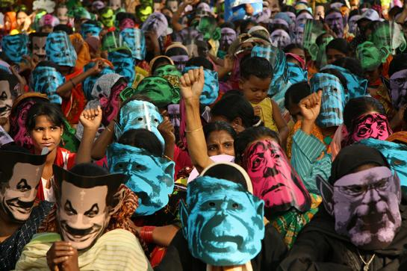
Where do we see people in a climate change debates?

Slide 10
Scope of Participation
Focusing on the process & then the product
Environmental Governance Group
Workshops: districts/agro-climatic zones/sectoral levels
  farmers, pastoralists, fisher folk, forest dwellers
  Industrial and other productive sectors
  Marginalized and other user communities directly dependent on natural resources;
Coordination and consultative meetings:
  Policy makers, regulators and PRIs
  Line agencies of government at state/district level
  Business and industries
  Civil society
Inputs from experts and organizations
  scientists, academicians, activists, cultural leaders.
Public Affairs Centre

Slide 11
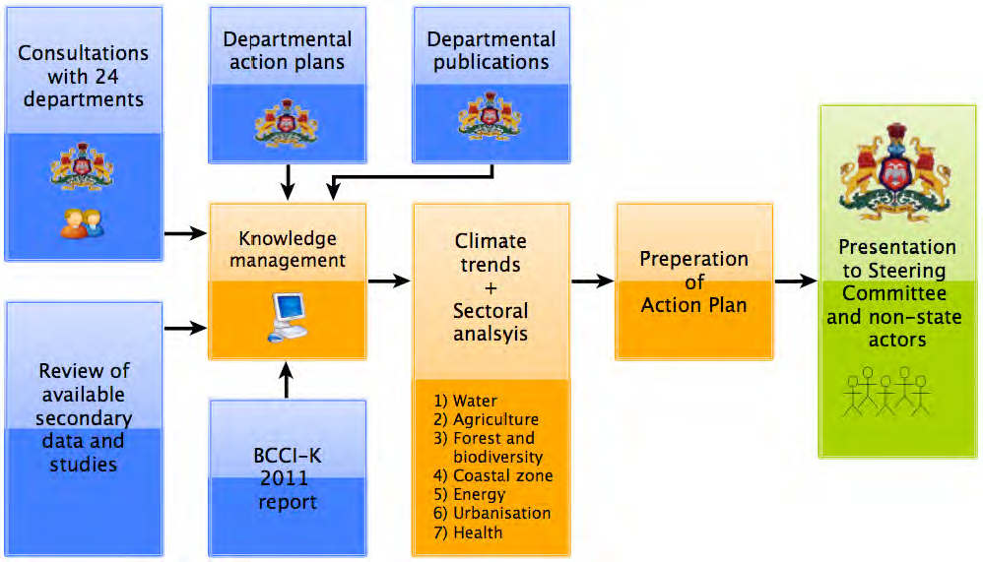
The reality shigting Focus from process to product
Environmental Governance Group
Public Affairs Centre

Slide 12
Exclusion by default
Environmental Governance Group
Stakeholders in the common framework includes farmers, fisherfolk, forest dwellers, Marginalised user communities, PRIs, Civil Society, cultural leaders, apart from the regular ones
However, as observed in KAPCC, stakeholder means STAKEHOLDER DEPARTMENTS & the Consortium of Research Institutions
Quite participatory indeed!!
Public Affairs Centre

Slide 13
Some major issues with KCCAP
Environmental Governance Group
Lack of transparency
Poor dissemination of information
Absence of a participatory approach
Deficient coordination between departments
Business as usual
Public Affairs Centre

Slide 14
Environmental Governance Group
“ I believe we have the greatest assets in the wisdom, creativity and enterprise of our people. The Plan intends to go beyond government to draw upon these assets.
Public Affairs Centre

Slide 15
Focus on the Process
Widening the definition of ‘stakeholders’
Wider consultations with civil society and other actors
Unveiling the veil of secrecy and confidentiality

Slide 16
Climate change is the public policy problem from hell.
Environmental Governance Group
“
Mother Jones: The Real Victims of Climate Change http://goo.gl/EpSDd
Public Affairs Centre

Slide 17
Climate change is the public policy problem from hell.
Environmental Governance Group
The poor are worst affected
Largely invisible
“
Slow-moving
Requires global coordination
Expensive to fix
Public Affairs Centre
Mother Jones: The Real Victims of Climate Change http://goo.gl/EpSDd

Slide 18
Environmental Governance Group
Karnataka Climate Change Action Plan
Sectors:
Agriculture
Water
Forests
Coast
Energy
Urbanisation
Health
Status
Climate Change Impacts
Climate Trends & GHG Emissions
Current Actions, Policies, Institutional Frameworks
Actions Required
Priorities, Entry Points
Public Affairs Centre

Slide 19
What is good about the Karnataka Action Plan?
Environmental Governance Group
Technically sound
Locally relevant
Fairly comprehensive
Provides good starting points
Has driven the compilation and generation of a first-rate, state & sub-state level analyses of climate, climate change trends and impacts.
IPCC ARs → INCCA → KCCAP
Public Affairs Centre

Slide 20
The Actions in the Action Plan?
Only appears to be the first attempt at rationalisation and harmonisation.
Time frames:
  Short term (Immediate
  Short term (1-2 years)
  Medium term (2-5 years)
  Long term (5-20 years)
Funding sources:
  No significant funding required.
  National Missions
  Yet to be identified

Slide 21
The Actions in the Action Plan?
Only appears to be the first attempt at rationalisation and harmonisation.
Time frames:
  Short term (Immediate
  Short term (1-2 years)
  Medium term (2-5 years)
  Long term (5-20 years)
Funding sources:
  No significant funding required.
  National Missions
  Yet to be identified
What is the real financial burden on the state?

Slide 22
Inclusiveness?
Environmental Governance Group
No acknowledgement of:
  The value of traditional knowledge and practices.
  Traditional livelihood rights
  The rights of indigenous peoples.
  The value of the Commons and CPRs
No mention of comprehensive education & capacity building of stakeholders
  Politicians
  Government employees: bureaucrats, engineers, others
  Communities & CBOs [With exceptions]
  Concerned citizens
  School & college students
Public Affairs Centre

Slide 23
But are people’s voices heard?
Environmental Governance Group
No references to vulnerable communities; livelihoods; sections of society. Only sectors and districts.
ONE mention of the word “gender”;
  The importance of maintaining adequate gender ratios.
FEW mentions of “women”;
  Women’s health & access to services
  Widespread deployment of improved chulas [in the future
  Support to Fisher women groups for fish marketing.
Equity?
Public Affairs Centre

Slide 24
What is the envisaged role of NGOs?
NGOs::
  IEC activities in Water:
  Rainwater harvesting awareness
  Micro-irrigation etc
  Climate Change education of farmers
  Farmer training for dryland agriculture
  Livestock insurance
  Mangrove promotion
  Portal & Database on Adaptation

Slide 25
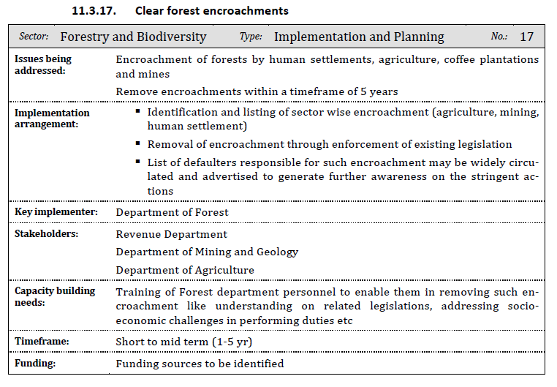
Environmental Governance Group

Slide 26
Environmental Governance Group
Use of Biotechnology:
  a. Genetic engineering for conversion of
  C‐3 crops to C‐4 crops , which can use the excess CO₂
  b. Development of crops with better water and nitrogen use efficiency
  c. Nutritional strategies for managing heat stress in dairy animals
  [In line with the National Action Plan]
Public Affairs Centre

Slide 27
The way forward
Environmental Governance Group
Climate Action plans involve complex processes and numerous actors.
Some thoughts on moving forward:
  Public education and Public consultations across the state.
  Data transparency and dissemination for public good.
  Coming up with complementary, supplementary and alternate views and documents.
  Picking our battles.
Public Affairs Centre

Slide 28




THANK YOU
kuldip@pacindia.org pavan.srinath@pacindia.org
www.facebook.com/Green.Gov
greengovernance.wordpress.com
@Green_Gov
Public Affairs Centre
Committed to Good Governance

Slide 29
Environmental Governance Group
Environmental Governance Group
Public Affairs Centre was established in Bangalore in 1994
An independent initiative to address the gap between public power and the civil society.
Environmental Governance Group started in 2010 as
  A resource centre to work with policy makers to bring out citizen centric policies for effective environmental governance;
  To work with grass root organizations and community groups in empowering the vulnerable communities to constructively engage with the governance structures to safe guard their lives and livelihoods.
Public Affairs Centre

Slide 30
The way forward
Environmental Governance Group
Climate Action plans involve complex processes and numerous actors.
Way forward:
  Wider consultations with civil society and other actors
  Widening the definition of ‘stakeholders’
  More informed debates on climate action plans across states
  Constructive engagement with vulnerable communities
  Incorporation of traditional knowledge, rights and concerns
  More transparency in planning & implementation processes, and in data & research
Public Affairs Centre

