Slide 1
Assessing Vulnerability in Semi- arid ecosystems
- grassroots perspective
WOTR - Maharashtra

Slide 2
In this presentation
Context – WOTR’s approach assessing and reducing vulnerability
Findings - case studies
Preliminary Conclusions

Slide 3
The Context :
  Watershed – how do we see it?
  the watershed is not only considered as a geographical area, but more as a “living space/ecosystem”
  Vulnerability assessment :
      Ecosystems approach: - Agro-ecological Zones
      Agro-ecological zone is the land unit carved out of agro-climatic zone superimposed on landform which acts as modifier to climate and length of growing period, & has sub – regions again
      5 capital approach (resource base) “multi- dimensional vulnerability”

Slide 4
Semi- arid ecosystems – characteristics
  Project area: Maharashtra, MP , AP , Rajasthan
Working in Agro-ecological Zones (AEZs) – 4 (4 sub-regions), 6 (4 sub-regions), 7 (3 sub-regions)

Slide 5
Why is the AEZ so important in context to Vulnerability ?
“ Typical characteristics that make the region/zone vulnerable – give us a direction to identify indicators”
To assess yield potentialities of different crops, possible crop combination
To formulate future plan of action involving crop
diversification.
To disseminate agricultural research and agro-technology to other homogenous areas.
To determine the crop suitability for optimization of land use

Slide 6
Semi- arid ecosystems – characteristics
Length of Growing Period
Available Water Capacity
General range , variation with in the sub-regions :
  <90 days : Feasible for single short duration crop
  90-150 days : Suitable for one medium duration crop or single short duration crop plus relay crop
  Available water capacity - high , medium & low
  Different soil types & textures

Slide 7
list of Constraints in AEZs
Alluvial soils :
  Coarser soil texture and low plant available water capacity (AWC).
  Over exploitation of groundwater, resulting in lowering of groundwater table in some areas
  At places, imperfect drainage conditions lead to spread of surface and subsurface soil salinity and/or sodicity.
Black soils :
  High runoff and erosion hazard during stormy cloud bursts.
  Prolonged dry spells during crop growing period resulting in occasional crop failure.
  Narrow range of workable soil moisture in Black soils.
  Subsoil sodicity affecting soil structure, drainage and oxygen availability, especially in ubdominant Black soils.
  High subsoil density in Red loamy soils limiting effective rooting depth.

Slide 8
Methodology used :
Reviewed numerous frameworks are available
Selected a few that are suitable
Watershed is unit, vulnerability to climate change is assessed at 3 levels :
    Watershed level (village)
    Production system level - sector specific agriculture, livestock , forests & non- farm livelihoods
    HH level – vulnerable groups identified
Implementation of projects
  position: “ indications”

Slide 9
Climate Trends
Increase in unpredictable rainfall pattern
Increase in intensity of rainfall ( heavy down pour)
Sudden prolonged rainfall (year 2010).
In the recent 15 years, heat spells and droughts have increased in the region (1997, 2003).
The region is also experiencing frequent changes in temperature and precipitation patterns

Slide 10
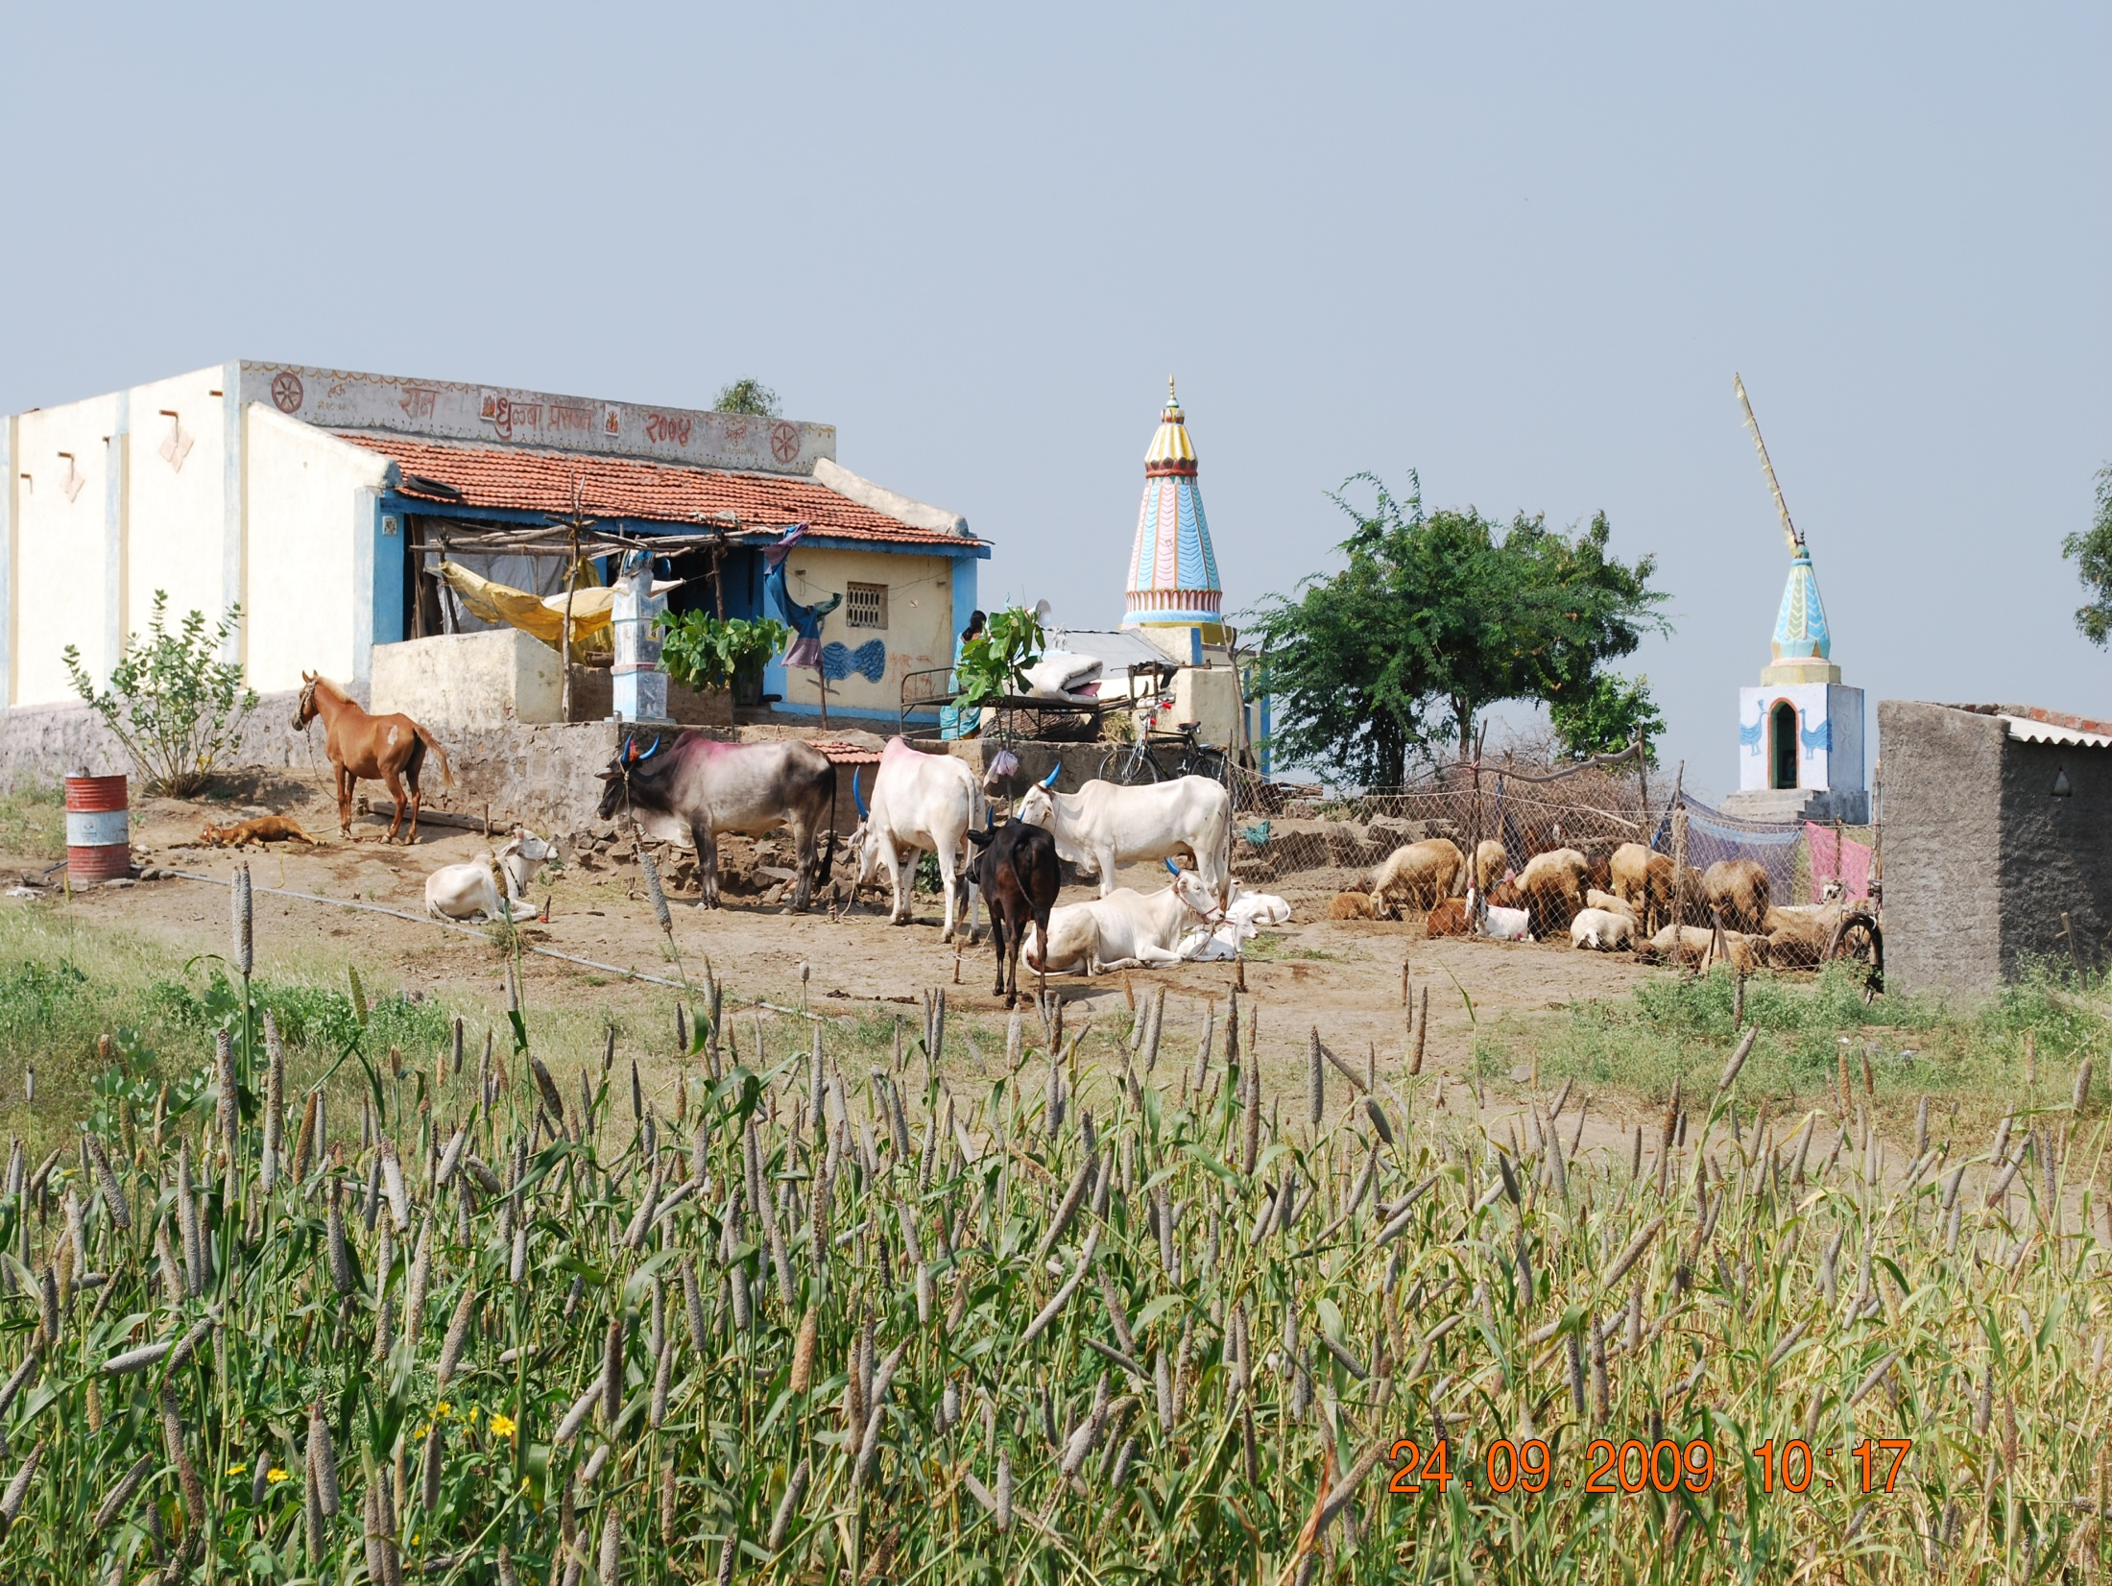
Case 1: production system & vulnerability ( Livestock)
Based on approach (AEZ ) – taken a position on livestock production
1. In resource fragile regions, livestock plays a critical role in supporting livelihoods
2. It goes beyond its food production function “multiple roles”
3. Farmers and pastoralists over time, developed and managed diverse local breeds that are adapted to the environment and the local feed resources they live in
4. It is this animal diversity, these special traits and traditional livestock rearing systems that demonstrate a resilience and adaptability to climate change, weather variations, offer stability to livelihoods

Slide 11
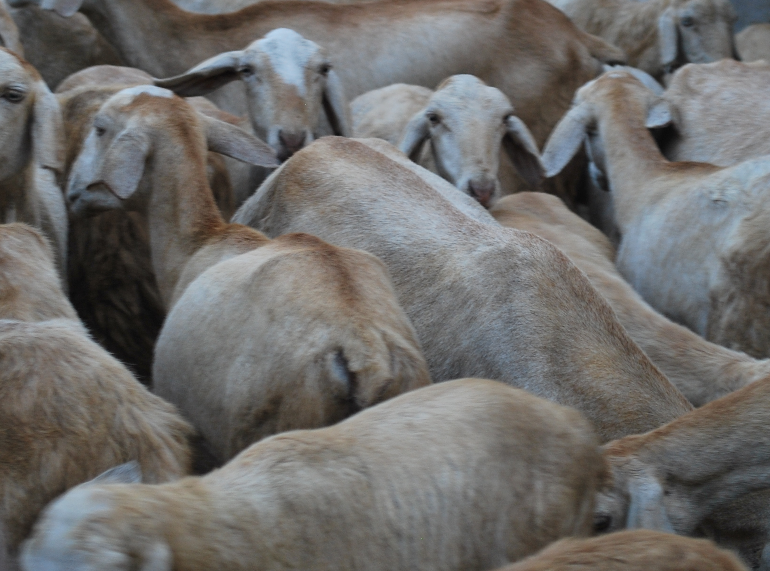
Key findings
Key drivers of change :
Increasing demand for livestock products & Animal Breeding programmes focused on single productive trait development
Cash flow, financial/food security, better quality life
Key pressures triggered change
Natural Resource Conservation and Management - ban on grazing & availability of continuous water
High agriculture market price fluctuations

Slide 12
Impacts on communities & ecosystem :
- Drastic reduction of Indigenous cattle breeds which are well adapted to local ecosystem& provided multiple services
- Replacement of small stock by high grade 75% Holstein Friesian cows
- Change from low input mixed crop-livestock production system to high –input cash crop – high grade crossbred dairy farming.
- Heavy shortages in farm yard manure and bullock power – heavy usage of chemical fertilizers/inputs
- Reduction in soil quality and water quality
- Injudicious use of water
- High energy usage - tractors, transport vehicles for farm operations & Bulk milk chiller etc
- Methane emissions - as high grade CB cows do not have the capacity to ingest or digest low quality fodder
- Loss of bio-diversity – enclosed cut & carry system of fodder extraction

Slide 13
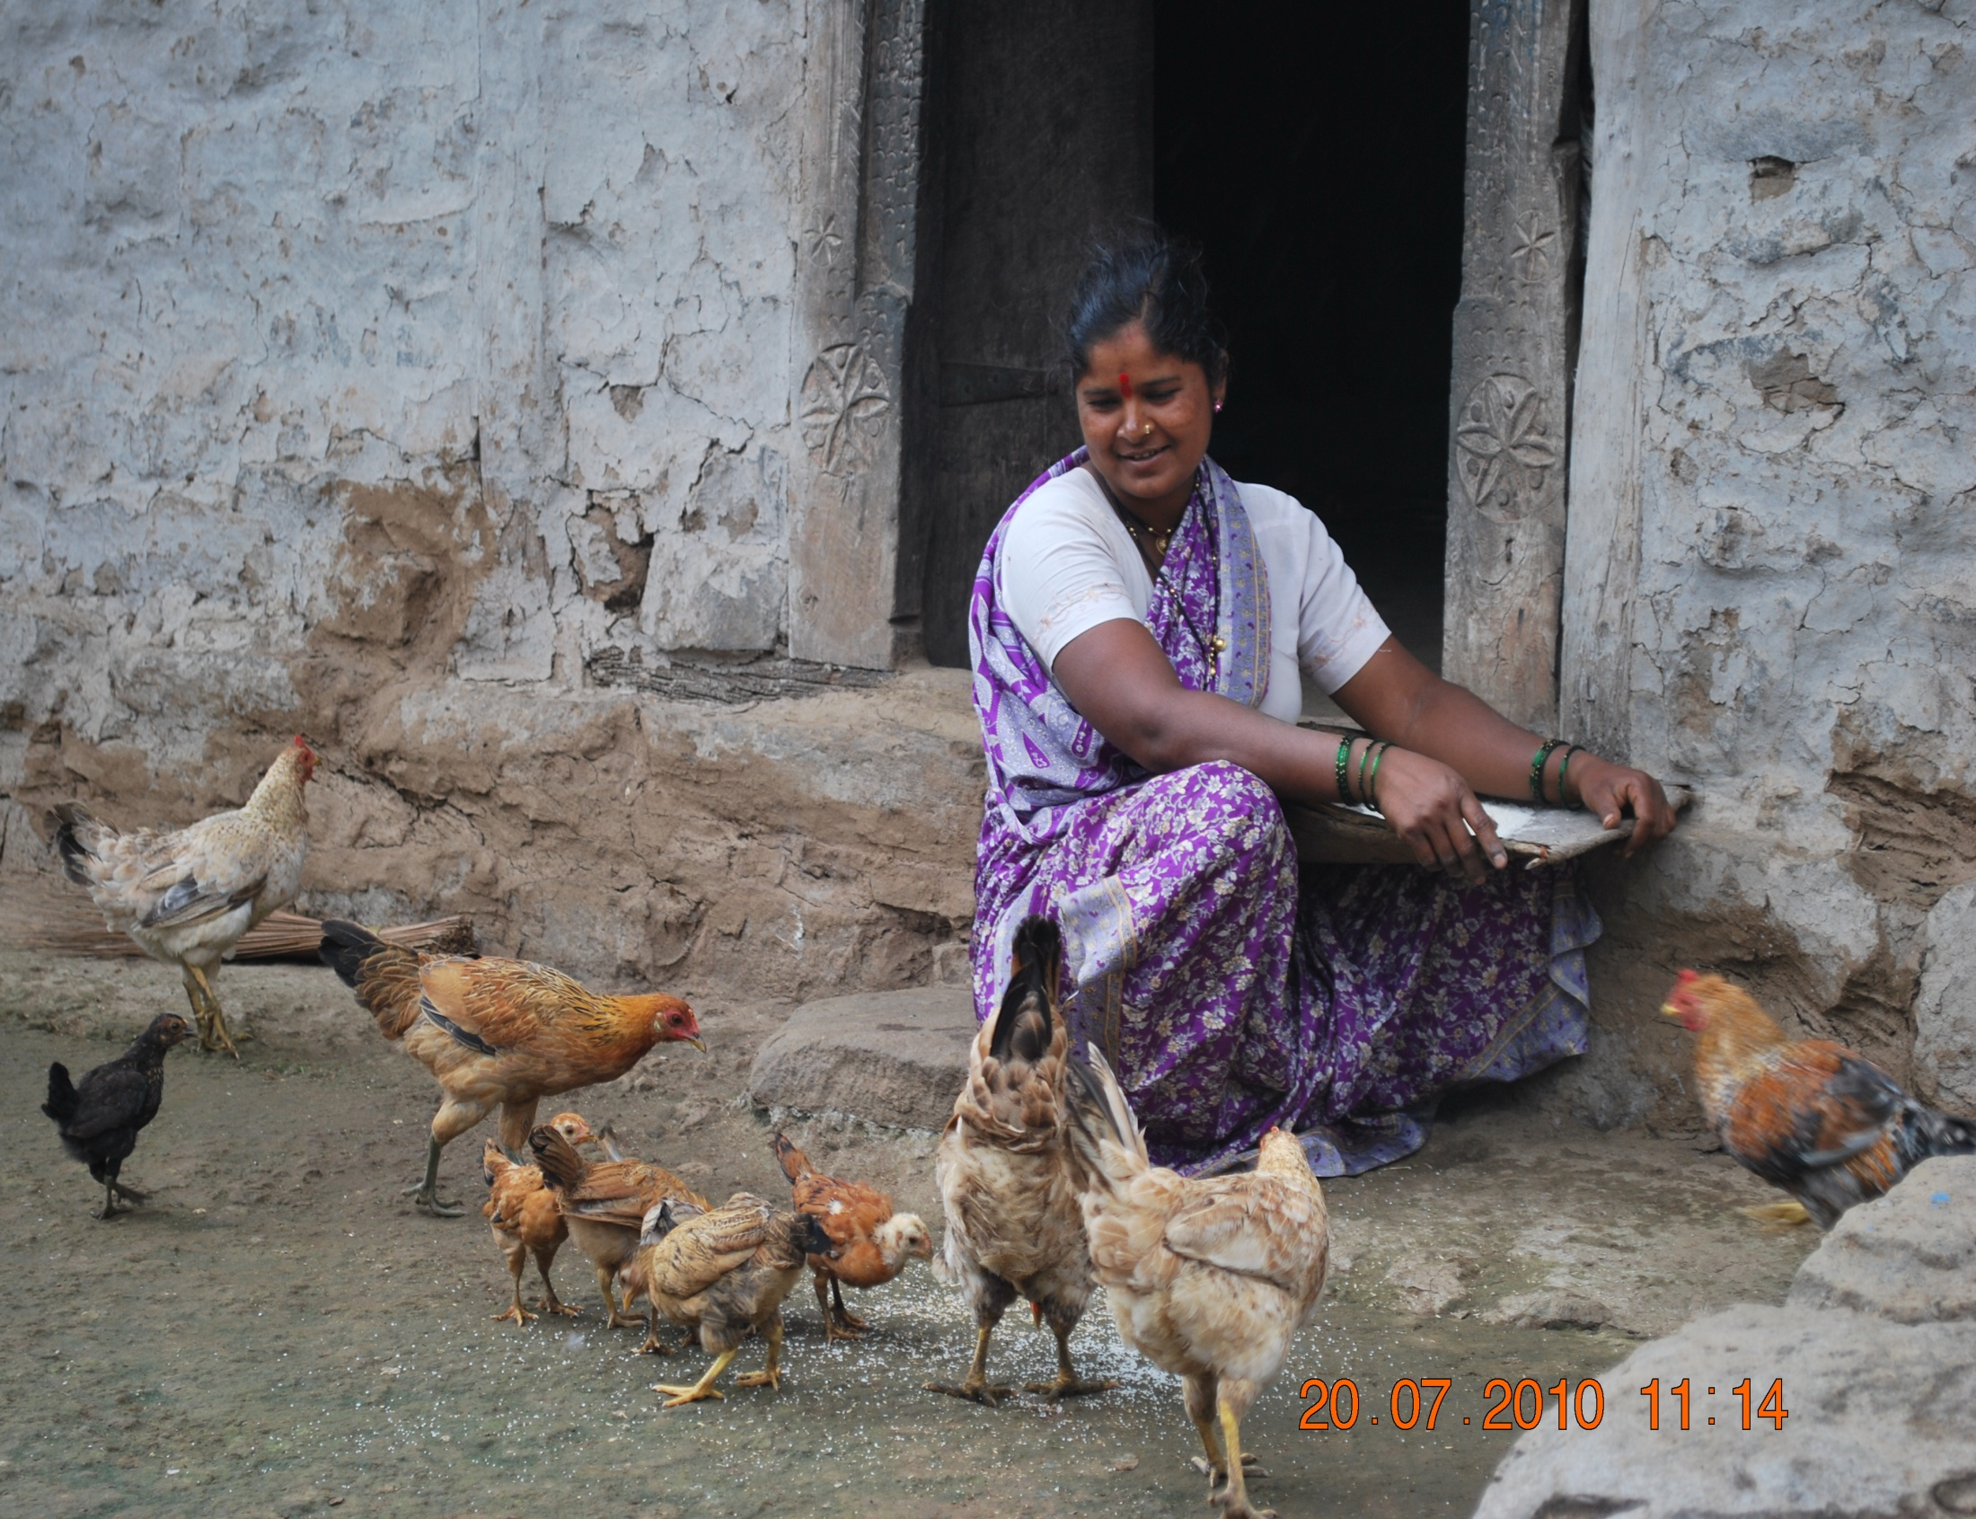
  Huge dependence on high-grade crossbred cows farming which is also water intensive livestock production systems in drought prone areas
  Significant reduction on small stock that an act as a buffer in times of emergency.
  Loss of multiple advantages provided by indigenous cattle (manure, bullock power etc.)
  Loss of financial and nutritional security for women and children due to reduction in small stock - back yard poultry and goats in particular.
  Lack of regulation of use of water for both crop and livestock farming
Indications for vulnerability

Slide 14
Case 2 : general vulnerability
  case 2.xlsx

Slide 15
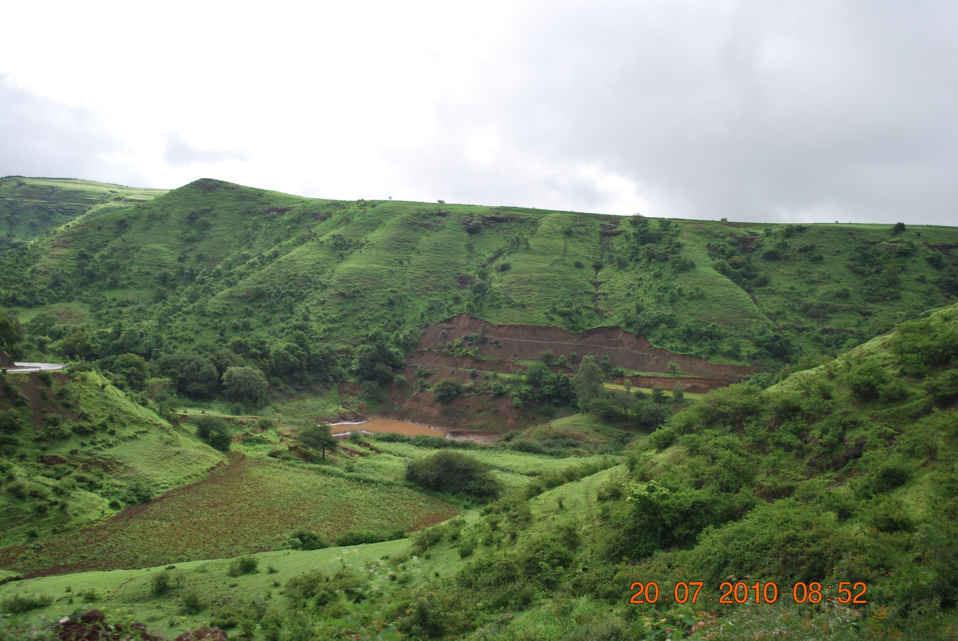
What is being done and how effective is it?
Communities continuously finding better options to reduce their vulnerability
Few responses decrease the sensitivity of the system
Majority are short-term fixes - reduce vulnerability temporarily but decreases the resilience of the system

Slide 16
Preliminary Conclusions :
The indications – are village specific “ high variability”
Vulnerability of communities in a region depend on various factors ( location, market access ....)
Developing a broad vulnerability index may not be useful
AEZ perspective & associated vulnerabilities need to be considered

